Slide 1
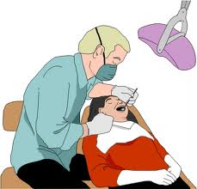
Low Level Laser for Dentists
Low level laser THERAPY (LLLt):
STIMULATES TISSUE REGENERATION
Speeds wound healing
Anti-inflammatory
Analgesic

Slide 2
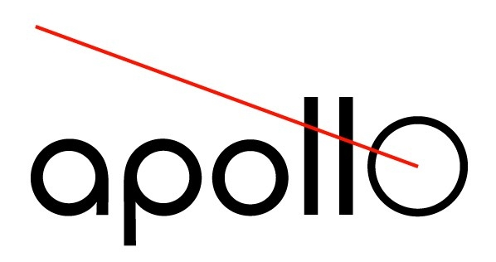
What is Low
Level Laser Therapy?
Presented by new line medical selling apollo: the world’s most powerful cold lasers

Slide 3
Laser Therapy
Historically referred to as:
  LLLT (low level laser therapy)
  LILT (low intensity laser therapy)
  Laser Biostimulation
  Low power laser therapy
  Cold laser therapy
  Note: LLLT best term for searching PubMed, the Nat’l Institutes of Health Public database
  Search: “ PubMed “

Slide 4
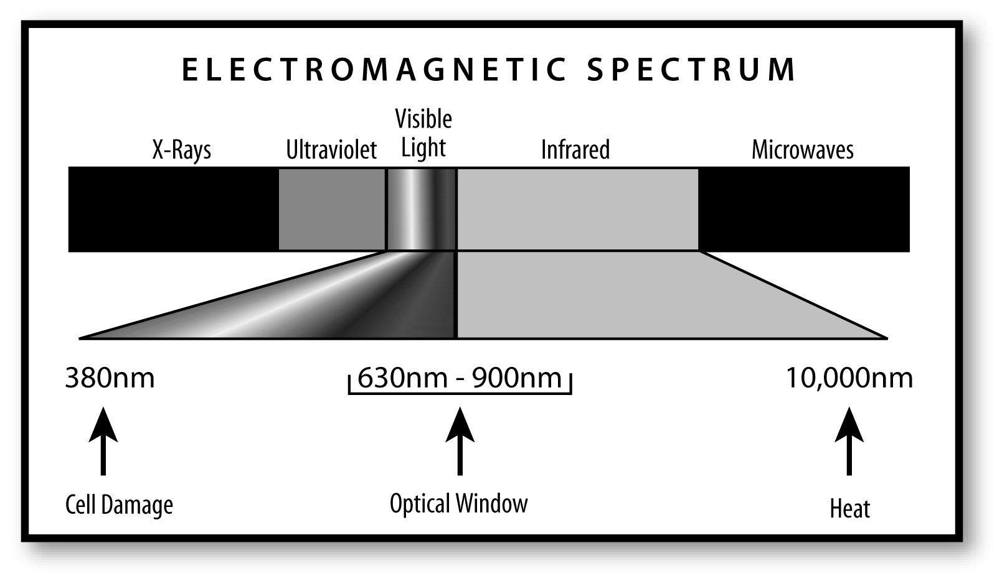
Electromagnetic Spectrum
Optical Window

Slide 5
Depth of Penetration
Lasers and LED’s of Optimal Wavelength Penetrate up to 23 cm (4 studies)
Desmet K, et al. Photomed Laser Surg. 2006 Jun;24(2):121-128

Slide 6
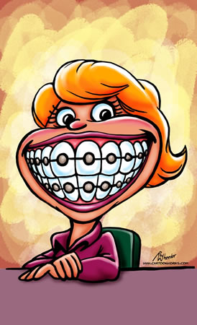
Cold Lasers are Safe

Slide 7
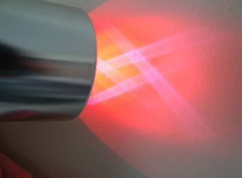
Beam of an Apollo Cold Laser
Note that there is a divergence of ± 38º, this creates a safe beam with less chance of injury
This is not true with hot, surgical lasers

Slide 8
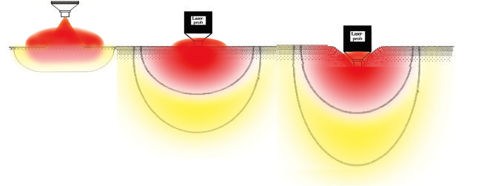
Contact is Most Effective
Treatment Technique
CONTACT WITH PRESSURE:
DEEPEST
NON-CONTACT:
DEEP
CONTACT:
DEEPER

Slide 9
Improves Cell Function of All Tissues

Slide 10
Improved Cell Function
INCREASES: cell proliferation, cell division, cell maturation, secretion of growth factors, wound healing, collagen production, wound strength, wound closer, fibroblasts, myofibroblasts, chondrocytes, osteoblasts, epithelialization, skin circulation, oxygen supply, activity satellite cell cultures (stem cells)
↓ Prostaglandin E2, substance P, cyclooxygenase 2 (Cox 2), muscle tension
J Clin Las Med Surg 2004; 22 (2)141-150

Slide 11
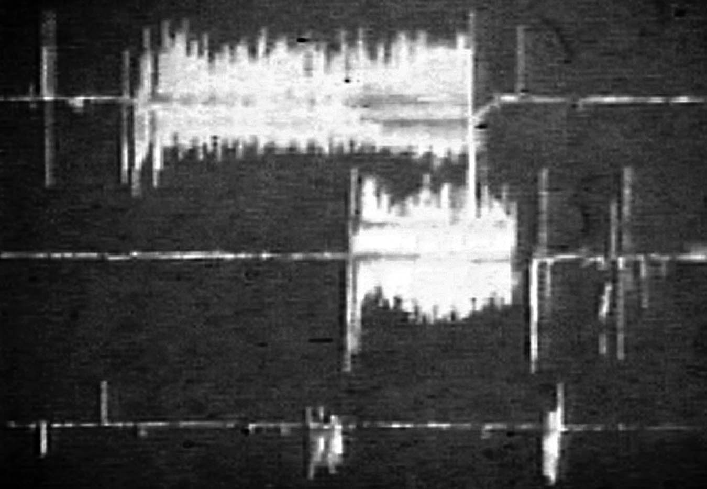
Laser Acts Like a Nerve Block
1 Laser treatment
2 Laser treatments

Slide 12
LLLT Compared to
Other Modalities

Slide 13
Laser vs. Ultrasound (US)
LLLT better than low-intensity pulsed ultrasound (LIPUS) or US on bone repair
  LLLT created repair bone →formation
  LLLT produced healthier, stronger bone
  LIPUS →bone resorption (weaker)
  J Rehab Res & Dev, Volume 41 Number 5, September/October 2004
  Photomed Laser Surg. 2006 Dec;24(6):735-40
  Lasers Med Sci. 2010 Jun 3.

Slide 14
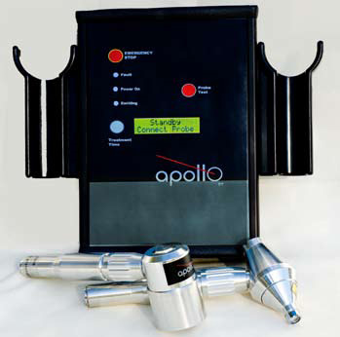
Laser vs. Ultrasound
LLLT more effective than US.
Better ↓ symptoms, pain and faster healing.
Laser more effective than US at stim healing, reducing pain.
Photomed Laser Surg. 2009 Jan 26.

Slide 15
Laser vs. Electrical Stimulation
FACT: Laser more effective at pain reduction & stimulating healing than electric stim.
Phys Ther. 2006 Jul;86(7):955-73.
J Appl Oral Sci. 2006 Apr;14(2):130-5
Photomed Laser Surg. 2006 Feb;24(1):45-9.
FACT: Laser as effective or more effective than electric stim and electrical acupuncture.
BMC Musculoskelet Disord. 2007 Jun 22;8:51.
FACT: Effective to use electrical stimulation while painting with laser; accomplishes a synergistic effect.
J Appl Oral Sci, Apr;14(2):130-5.

Slide 16
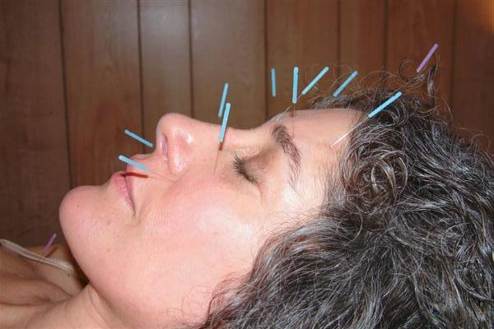
Laser Like Acupuncture?
Acupuncture stimulation and laser both increase diameter of the local vessels and increase blood flow.
Anesth Analg 2009 Feb;108(2):635-40

Slide 17
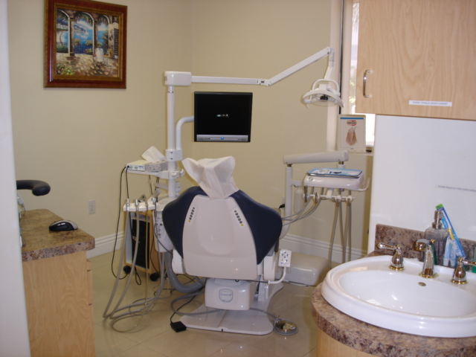
How Low Level Laser
Fits into a Dental Practice

Slide 18
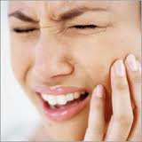
TMJ and TMD

Slide 19
TMJ and TMD
The treatment lessened the pain symptoms in the experimental groups TMJ musculature.
Cranio. 2010 Apr;28(2):84-91.
Cranio. 2007 Jul;25(3):186-92.
LLLT is effective reducing TMD symptoms, and improves masticatory efficiency.
Cranio. 2008 Oct;26(4):274-81
LLLT was effective for pain reduction in Myofascial Pain Disorder.
Lasers Med Sci. 2009 Sep;24(5):715-20.

Slide 20
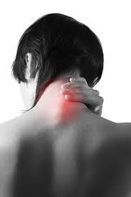
Lasers and Neck Pain
Meta-analysis; 820 patients.
Clear benefit for chronic neck pain.
Side-effects same as placebo.
LLLT reduced pain almost immediately
Results lasted up to 22 weeks.
Lancet. 2009 Nov 12.

Slide 21
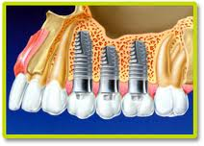
Implantology

Slide 22
Implantology
LLLT provides faster implant placement compared to non-laser treated socket grafts.
Implant Dent. 2007 Jun;16(2):204-11
LLLT increases osteoblast proliferation, promotes bone healing following periodontal and implant therapy.
Lasers Med Sci. 2010 Jul;25(4):559-69
LLLT promoted the osseointegration of implants with poor initial stability.
Photomed Laser Surg. 2010 Jun;28(3):365-9.

Slide 23
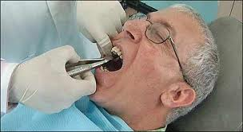
General Dentistry

Slide 24
General Dentistry
LLLT reduces postoperative trismus and swelling after third molar surgery.
Photomed Laser Surg. 2009 Feb;27(1):21-4.
LLLT enhances epithelization and improves wound healing after gingivectomy and gingivoplasty.
J Clin Periodontol. 2008 Mar;35(3):250-4.

Slide 25
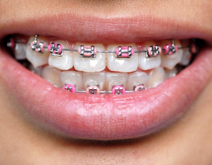
Orthodontia

Slide 26
Orthodontia
LLLT facilitates the velocity of tooth movement and bone healing.
Orthod Craniofac Res. 2009 Nov;12(4):289-98
Eur J Orthod. 2010 Apr;32(2):131-9.
LLLT efficiently controls pain caused by the first archwire.
Am J Orthod Dentofacial Orthop. 2009 Nov;136(5):662-7
LLLT leads to a faster repair of pulpal tissue due to orthodontic movement.
Angle Orthod. 2010 Jan;80(1):116-22.

Slide 27
Periodontal Disease

Slide 28
Periodontal Disease
LLLT can have a beneficial effect for treating inflammatory chronic advanced periodontitis.
Gen Dent. 2009 Sep-Oct;57(5):510-3.
Positive effect of LLLT in accelerating periodontal wound healing. Lasers Med Sci. 2009 May;24(3):387-95.

Slide 29
Oral Mucositis
NASA Light Emitting Diodes for the Prevention of Oral Mucositis in Pediatric Bone Marrow Transplant Patients
Double blind (sham irradiation on contralateral side)
32 pediatric patients.
Daily treatment for 14 days
Pain reduced by 48 %!!!
H Whelan et al , J.Clin laser Medicine & Surgery, Vol 20 (6) pp319-324

Slide 30
Thank You!
New line medical and apollo

